Slide 1
UPPER SIXTH ARTS
GEOGRAPHY
Quantitative Techniques 1
Analysis of Cartographic Tools
Notes:
Good morning, class, and welcome to our geography lesson. I am your geography teacher, Mr Kamdem. Today we are starting Quantitative Techniques 1: Analysis of Cartographic Tools.

Slide 2
CLASS INFO
Class, Chapter and Duration
Class | Upper Sixth Arts
Chapter | Module 8: Understanding and carrying out statistical techniques, topographic map analysis, fieldwork and project based learning
Duration | 2 periods (2 × 50 minutes)
Notes:
This lesson is for Upper Sixth Arts. It belongs to Module 8: Understanding and carrying out statistical techniques, topographic map analysis, fieldwork and project based learning. We shall need 2 periods to cover it.

Slide 3
IDENTIFICATION
Lesson Identification
Topic | Quantitative Techniques in Geography
Sub-topic | Cartographical techniques
Lesson | Quantitative Techniques 1: Analysis of Cartographic Tools
Notions / Concepts | Choropleth, isopleth, dot map, proportional circles, star diagram, flow-line map, population pyramid, Lorenz curve.
Syllabus focus | Interpretation of choropleth, isopleth and dot maps, hachures, proportional circles, pyramids, star diagrams, flow-line maps and the Lorenz curve.
Competence | Learners are able to choose, read and interpret cartographic tools.
Notes:
Our topic is Quantitative Techniques in Geography, and the sub-topic is Cartographical techniques. The key notions we shall use today are: choropleth, isopleth, dot map, proportional circles, star diagram, flow-line map, population pyramid, Lorenz curve. At the end, you should be able to do this: learners are able to choose, read and interpret cartographic tools.

Slide 4

HOMEWORK CORRECTION
Correction of the Homework
Question (Map Analysis 9: Urban Settlements on Maps):
Draw a sketch map of the functional zones of your town.
Notes:
Before we start the new lesson, let us correct the homework I gave you at the end of Map Analysis 9: Urban Settlements on Maps. The question was: Draw a sketch map of the functional zones of your town. Take out your exercise books.

Slide 5
HOMEWORK CORRECTION
Correction: Possible Answer
A good sketch shows the frame, title, key, scale and north arrow, with the market/centre, administrative quarter, residential areas and any factories or open land.
Notes:
Here is a good answer. A good sketch shows the frame, title, key, scale and north arrow, with the market/centre, administrative quarter, residential areas and any factories or open land. Compare it with your own answer and correct your work in red.

Slide 6
LESSON PLAN
Lesson Plan
Correction of the homework
Objectives and recall
Real-life situation and action to take
Learning activities
Board summary
Evaluation, remediation and homework
Notes:
Here is the plan of our lesson today. First, we shall correct the homework. Then we shall look at the objectives and recall what you already know. After that, we shall study a situation from real life and the action to take, and do the learning activities. Finally, we shall copy the board summary, do the evaluation and the remediation, and I will give you the homework.

Slide 7
OBJECTIVES
Objectives
By the end of this lesson, you should be able to:
Distinguish the main types of statistical maps.
Interpret proportional circles, star diagrams and flow-line maps.
Notes:
Take your time to copy this part; we will continue together.

Slide 8
OBJECTIVES
Objectives (continued)
Interpret the Lorenz curve.
Notes:
By the end of this lesson, you should be able to do three things. Number 1: distinguish the main types of statistical maps. Number 2: interpret proportional circles, star diagrams and flow-line maps. Number 3: interpret the Lorenz curve.

Slide 9
PREVIOUS KNOWLEDGE
Previous Knowledge
Maps can show data.
Population density differs between regions.
Notes:
Let us first remember what you already know. Maps can show data. Population density differs between regions. Keep this in mind, because we shall build on it today.

Slide 10
REAL-LIFE SITUATION
Situation in Real Life
The Regional Delegation of Planning gives the class data on population, rainfall and migration. It asks which type of map is best for each set of data.
Notes:
Listen carefully to this situation from real life. The Regional Delegation of Planning gives the class data on population, rainfall and migration. It asks which type of map is best for each set of data. Think about it, because I am going to ask you some questions.

Slide 11
REAL-LIFE SITUATION
Situation: Question 1
What is the problem in the situation?
Notes:
Question 1: What is the problem in the situation? Think for a moment, then raise your hand to answer.

Slide 12
REAL-LIFE SITUATION
Answer
The class must choose the right map for each data set.
Notes:
Good. The class must choose the right map for each data set.

Slide 13
REAL-LIFE SITUATION
Situation: Question 2
Which map suits rainfall?
Notes:
Question 2: Which map suits rainfall? Think for a moment, then raise your hand to answer.

Slide 14
REAL-LIFE SITUATION
Answer
An isopleth map (isohyets).
Notes:
Good. An isopleth map (isohyets).

Slide 15
REAL-LIFE SITUATION
Situation: Question 3
Which map suits migration?
Notes:
Question 3: Which map suits migration? Think for a moment, then raise your hand to answer.

Slide 16
REAL-LIFE SITUATION
Possible Answer
A flow-line map.
Notes:
Good. A flow-line map.

Slide 17
ACTION TO TAKE
Action to Take
Choose the right cartographic tool for the data you have.
Notes:
From this situation, the action we are working towards in this lesson is the following: choose the right cartographic tool for the data you have.

Slide 18
JUSTIFICATION
Justification of the Lesson
This lesson helps us to present and read geographical data on maps.
Notes:
Why is this lesson important for you? This lesson helps us to present and read geographical data on maps.

Slide 19

1. CHOROPLETH AND DOT MAPS
Activity 1
A choropleth map.
Notes:
Activity 1. Look carefully at this diagram: a choropleth map. Observe every detail before I ask the question.

Slide 20
1. CHOROPLETH AND DOT MAPS
Activity 1: Question
Give one advantage and one disadvantage of a choropleth map.
Notes:
Here is the question for Activity 1: Give one advantage and one disadvantage of a choropleth map. Take one minute to think and write your answer in your rough notebook.

Slide 21
1. CHOROPLETH AND DOT MAPS
Activity 1: Answer
Advantage: easy to compare regions. Disadvantage: sudden changes at boundaries.
Notes:
Let us check the answer together. Advantage: easy to compare regions. Disadvantage: sudden changes at boundaries.

Slide 22
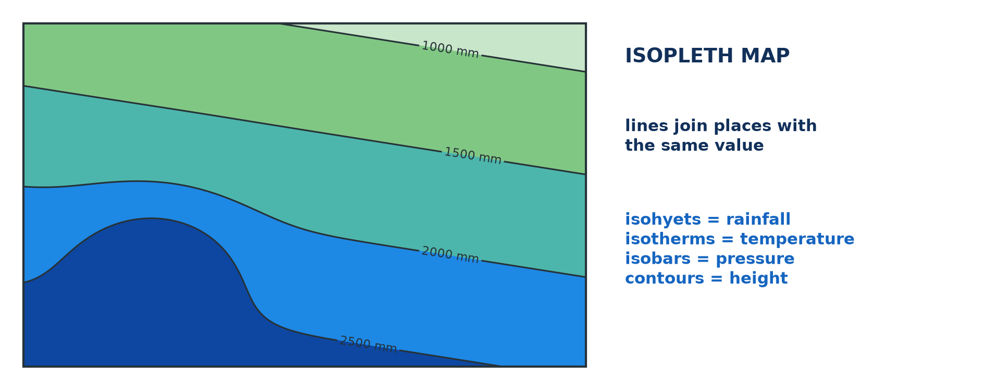
1. ISOPLETH MAPS
Activity 2
An isopleth map.
Notes:
Activity 2. Look carefully at this diagram: an isopleth map. Observe every detail before I ask the question.

Slide 23
1. ISOPLETH MAPS
Activity 2: Question
What is an isopleth? Give two examples.
Notes:
Here is the question for Activity 2: What is an isopleth? Give two examples. Take one minute to think and write your answer in your rough notebook.

Slide 24
1. ISOPLETH MAPS
Activity 2: Answer
A line joining equal values: isohyets (rain), isotherms (temperature).
Notes:
Let us check the answer together. A line joining equal values: isohyets (rain), isotherms (temperature).

Slide 25
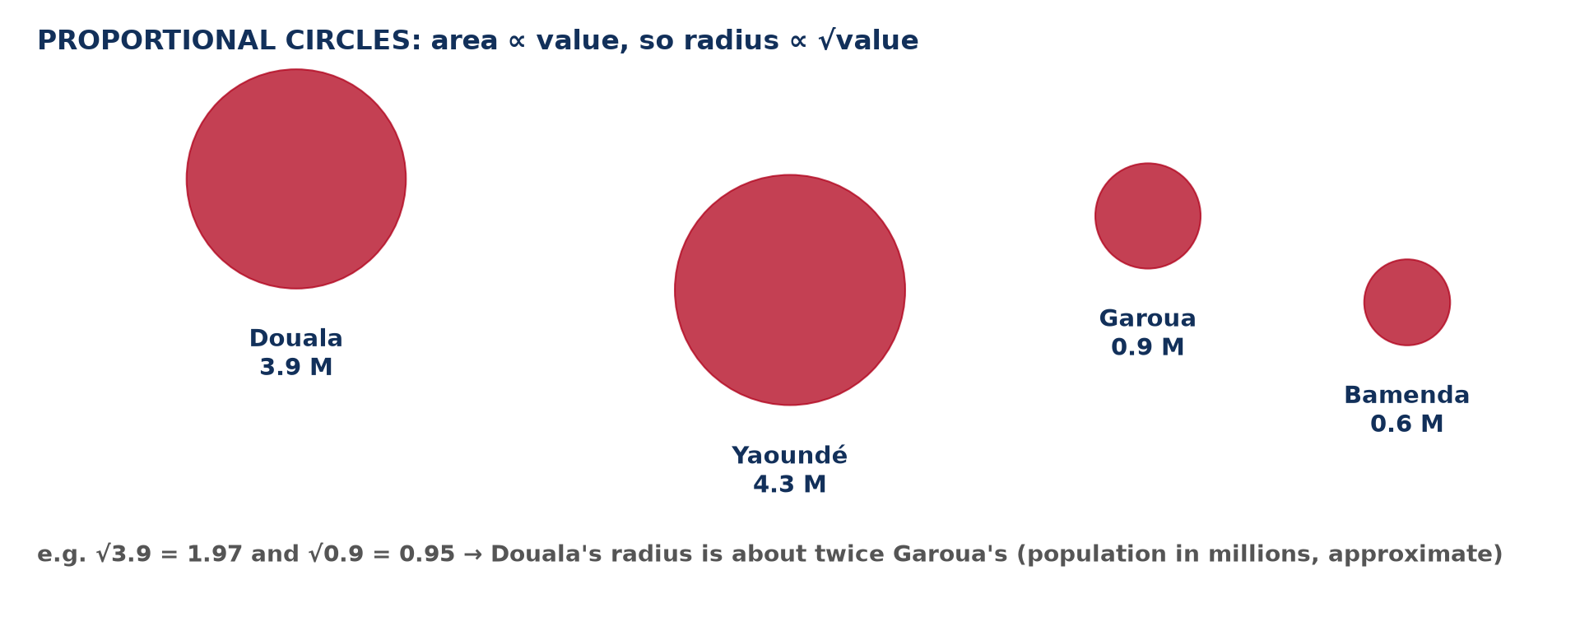
2. PROPORTIONAL CIRCLES
Activity 3
Proportional circles.
Notes:
Activity 3. Look carefully at this diagram: proportional circles. Observe every detail before I ask the question.

Slide 26
2. PROPORTIONAL CIRCLES
Activity 3: Question
Why is the radius proportional to the square root of the value?
Notes:
Here is the question for Activity 3: Why is the radius proportional to the square root of the value? Take one minute to think and write your answer in your rough notebook.

Slide 27
2. PROPORTIONAL CIRCLES
Activity 3: Answer
So that the circle's area matches the value.
Notes:
Let us check the answer together. So that the circle's area matches the value.

Slide 28
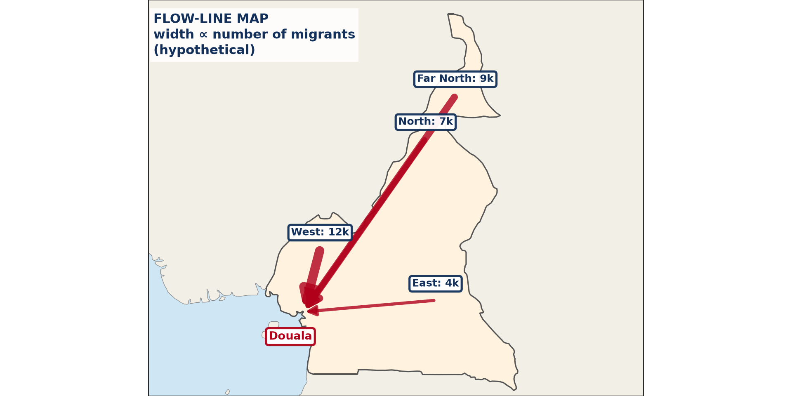
2. STAR AND FLOW MAPS
Activity 4
A flow-line map (hypothetical).
Notes:
Activity 4. Look carefully at this diagram: a flow-line map (hypothetical). Observe every detail before I ask the question.

Slide 29
2. STAR AND FLOW MAPS
Activity 4: Question
What does the width of a flow line show?
Notes:
Here is the question for Activity 4: What does the width of a flow line show? Take one minute to think and write your answer in your rough notebook.

Slide 30
2. STAR AND FLOW MAPS
Activity 4: Answer
The volume of movement (e.g. number of migrants).
Notes:
Let us check the answer together. The volume of movement (e.g. number of migrants).

Slide 31
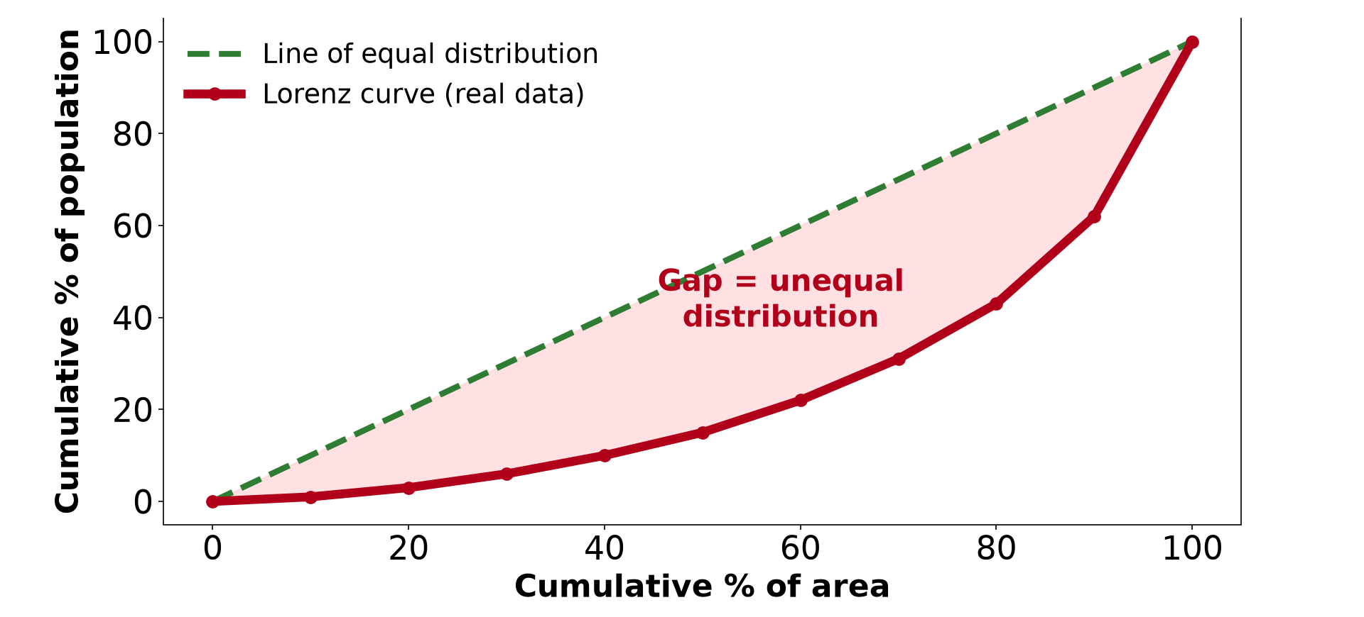
3. LORENZ CURVE
Activity 5
A Lorenz curve.
Notes:
Activity 5. Look carefully at this diagram: a Lorenz curve. Observe every detail before I ask the question.

Slide 32
3. LORENZ CURVE
Activity 5: Question
What does a curve far from the diagonal show?
Notes:
Here is the question for Activity 5: What does a curve far from the diagonal show? Take one minute to think and write your answer in your rough notebook.

Slide 33
3. LORENZ CURVE
Activity 5: Answer
A very unequal distribution.
Notes:
Let us check the answer together. A very unequal distribution.

Slide 34
BOARD SUMMARY
Board Summary
Topic: Quantitative Techniques in Geography
Sub-topic: Cartographical techniques
Quantitative Techniques 1: Analysis of Cartographic Tools
Notes:
Now we are going to copy the board summary. Write the title and the headings neatly in your notebooks. I will give you enough time for each slide, so do not rush.

Slide 35
BOARD SUMMARY
1. Choropleth, Isopleth and Dot Maps
These maps show distributions as follows:
Choropleth map: Areas are shaded according to a value, such as population density. It is easy to compare regions but shows sudden changes at boundaries.
Notes:
Let us copy Choropleth, Isopleth and Dot Maps. These maps show distributions as follows. On this slide we have Choropleth map. Write each point on a new line, with the key term first, and explain it in your own words when we revise. When you finish, we go to the next slide.

Slide 36
BOARD SUMMARY
1. Choropleth, Isopleth and Dot Maps (continued)
Isopleth map: Lines join places of equal value, such as isohyets or isotherms. It shows gradual change but needs many data points.
Notes:
We continue with Choropleth, Isopleth and Dot Maps. On this slide we have Isopleth map. Write each point on a new line, with the key term first, and explain it in your own words when we revise. When you finish, we go to the next slide.

Slide 37
BOARD SUMMARY
1. Choropleth, Isopleth and Dot Maps (continued)
Dot map and hachures: Each dot represents a fixed number, such as 1,000 people. Hachures are short lines showing the direction of slope.
Notes:
We continue with Choropleth, Isopleth and Dot Maps. On this slide we have Dot map and hachures. Write each point on a new line, with the key term first, and explain it in your own words when we revise.

Slide 38
BOARD SUMMARY
1. Choropleth, Isopleth and Dot Maps
Illustration: an isopleth map
Notes:
Now draw this illustration in your notebook: an isopleth map. Give it a title and label it clearly.

Slide 39
BOARD SUMMARY
2. Proportional Symbols, Star and Flow Maps
These tools show quantities and movements:
Proportional circles: The radius is proportional to the square root of the value, so the area matches the value. They compare totals such as town populations.
Notes:
Let us copy Proportional Symbols, Star and Flow Maps. These tools show quantities and movements. On this slide we have Proportional circles. Write each point on a new line, with the key term first, and explain it in your own words when we revise. When you finish, we go to the next slide.

Slide 40
BOARD SUMMARY
2. Proportional Symbols, Star and Flow Maps (continued)
Star diagrams: Lines radiate from a point, with lengths showing values in different directions. They show wind directions or trips.
Flow-line maps: The width of each line shows the volume of movement, such as migrants or goods. Arrows show the direction.
Notes:
We continue with Proportional Symbols, Star and Flow Maps. On this slide we have Star diagrams and Flow-line maps. Write each point on a new line, with the key term first, and explain it in your own words when we revise.

Slide 41
BOARD SUMMARY
2. Proportional Symbols, Star and Flow Maps
Illustration: a flow-line map (hypothetical)
Notes:
Now draw this illustration in your notebook: a flow-line map (hypothetical). Give it a title and label it clearly.

Slide 42
BOARD SUMMARY
3. Pyramids and the Lorenz Curve
These graphs show structure and inequality:
Population pyramid: It shows the age and sex structure of a population with horizontal bars. A wide base shows a young population.
Notes:
Let us copy Pyramids and the Lorenz Curve. These graphs show structure and inequality. On this slide we have Population pyramid. Write each point on a new line, with the key term first, and explain it in your own words when we revise. When you finish, we go to the next slide.

Slide 43
BOARD SUMMARY
3. Pyramids and the Lorenz Curve (continued)
Lorenz curve: It shows how evenly a value is shared by comparing cumulative percentages. The further the curve is from the diagonal, the more unequal the distribution.
Notes:
We continue with Pyramids and the Lorenz Curve. On this slide we have Lorenz curve. Write each point on a new line, with the key term first, and explain it in your own words when we revise.

Slide 44
BOARD SUMMARY
3. Pyramids and the Lorenz Curve
Illustration: a Lorenz curve
Notes:
Now draw this illustration in your notebook: a Lorenz curve. Give it a title and label it clearly.

Slide 45
FORMATIVE EVALUATION
Evaluation 1
Which map would you use for rainfall, population by region and migration?
Notes:
Now let us check what you have understood. Question 1: Which map would you use for rainfall, population by region and migration? Answer in your exercise book.

Slide 46
FORMATIVE EVALUATION
Expected Answer
Isopleth, choropleth, flow-line.
Notes:
The expected answer is: isopleth, choropleth, flow-line. If you got it right, well done.

Slide 47
FORMATIVE EVALUATION
Evaluation 2
Values 16 and 4: compare the radii of proportional circles.
Notes:
Now let us check what you have understood. Question 2: Values 16 and 4: compare the radii of proportional circles. Answer in your exercise book.

Slide 48
FORMATIVE EVALUATION
Expected Answer
√16 = 4 and √4 = 2: the first radius is twice the second.
Notes:
The expected answer is: √16 = 4 and √4 = 2: the first radius is twice the second. If you got it right, well done.

Slide 49
REMEDIATION
Remediation
Fill in the blanks:
Lines of equal rainfall are ______.
Circle radius ∝ the square ______ of the value.
Movement is shown on a ______ map.
Notes:
For those who need more practice, fill in the blanks in your exercise book. The answers are: number 1, isohyets; number 2, root; number 3, flow-line.

Slide 50
HOMEWORK
Homework
Name two sources of secondary data.
Notes:
For your homework: Name two sources of secondary data. We shall correct it at the beginning of our next lesson.

Slide 51
NEXT LESSON
Next Lesson
Our next lesson will be on:
Quantitative Techniques 2: Data Collection: Sources and Techniques
Notes:
Our next lesson will be on Quantitative Techniques 2: Data Collection: Sources and Techniques. Thank you for your attention, and see you next time.

Slide 52
BILINGUAL GAME
Bilingual Game (Jeu Bilingue)
English | Français
Choropleth map | La carte choroplèthe
Isopleth | L'isoligne
Dot map | La carte par points
Flow line | Le flux
Pyramid | La pyramide
Distribution | La répartition
Notes:
Let us play the bilingual game. I say a word in English, and you give me the French word. Then we do the reverse.

Slide 53
LOGBOOK
Official Logbook (1/2)
Module / Topic | Quantitative Techniques in Geography
Lesson Title | Quantitative Techniques 1: Analysis of Cartographic Tools
Expected Learning Outcomes | Distinguish the main types of statistical maps. Interpret proportional circles, star diagrams and flow-line maps. Interpret the Lorenz curve.
Competence | Learners are able to choose, read and interpret cartographic tools.
Notes:
I record this information in the official logbook of the class after the lesson.

Slide 54
LOGBOOK
Official Logbook (2/2)
Matter Taught | Choropleth, Isopleth and Dot Maps; Proportional Symbols, Star and Flow Maps; Pyramids and the Lorenz Curve.
Evaluation | Formative evaluation and remediation exercise.
Homework | Name two sources of secondary data.
Enrolment / Present / Absent | ____ / ____ / ____
Achievement | To be completed after the lesson.
Notes:
I complete the second page of the logbook: the matter taught, the evaluation, the homework and the attendance.

Slide 55
TEACHER'S NOTE
Teacher's Note
Timing: Homework correction, plan, objectives 8 min | Recall, situation, action 10 min | 5 activities 30 min | Board summary (copying) 30 min | Evaluation, remediation 10 min | Homework, next lesson 5 min | Logbook 7 min
Without the projector (Activity 1): read the map.
Without the projector (Activity 2): name isolines.
Without the projector (Activity 3): calculate radii.
Without the projector (Activity 4): read the flows.
Without the projector (Activity 5): interpret the curve.
Notes:
This slide is for me, the teacher: it gives the timing of the lesson and what to do if the projector is not available.

Slide 56
REFERENCES
References
National Geography Syllabus, MINESEC/IGE/IP-SS, 2019 — Module 8 (Practical Geography).
Diagrams and animations: drawn for this lesson (Geography Department).
Notes:
These are the references and picture credits used to prepare this lesson.

